Slide 1
PCA and Clustering

Slide 2
Problem Statement:
HELP International is an international humanitarian NGO that is committed to fighting poverty and providing the people of backward countries with basic amenities and relief during the time of disasters and natural Calamities. Hence as a analyst, We need help the organisation in choosing the countries that are in dire need.

Slide 3
Analysis Report

Slide 4
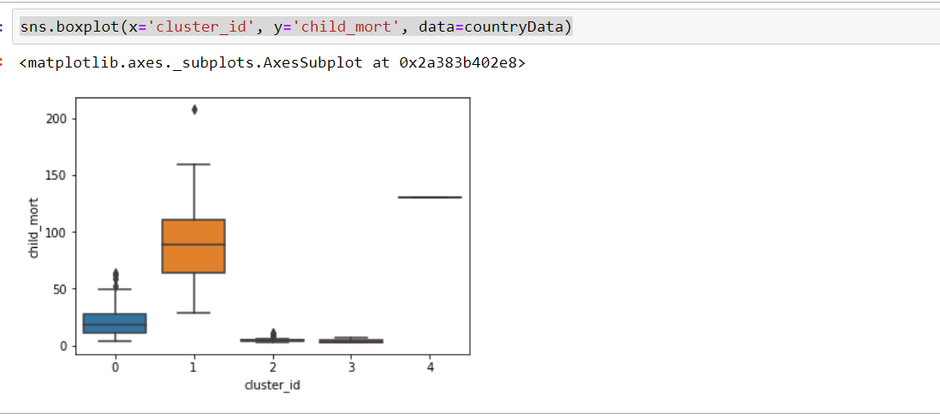
Child mortality v/s Cluster group

Slide 5
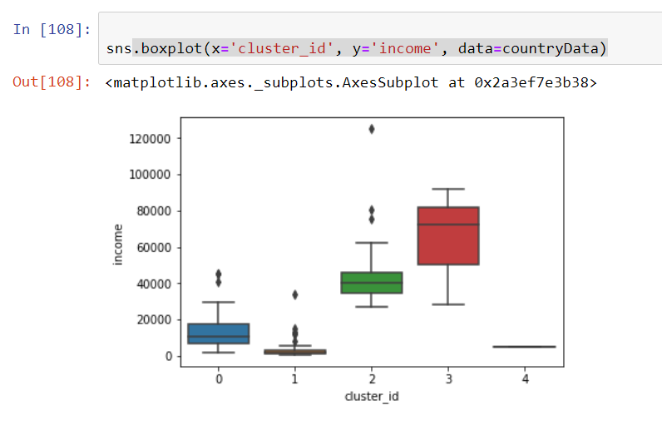
Income v/s cluster group

Slide 6
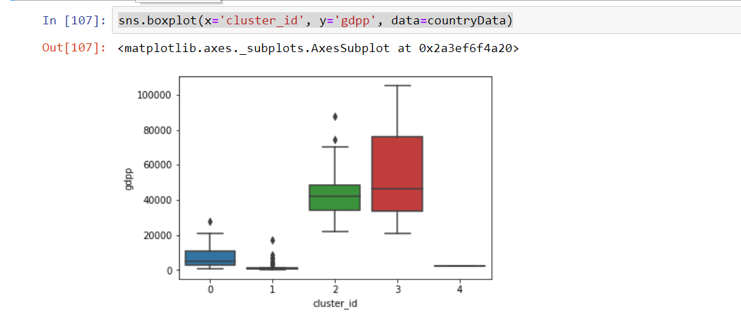
Gdpp v/s Clusters

Slide 7
Inferences
Looking at the box plots of clusters , we can see that
cluster 4 has high child mortality, low gdp, low income
cluster 2 and 3 has low child mortality and high gdp and income
cluster 1 has low income , low gdp and high child mortality
Looking at column 0 , it has moderate income , gdp and child mortality compared to other clusters
Based on the above inferences, We can see that cluster 4 and 1 needs more financial support.

Slide 8
Countries that are in dire need of monetary support.
Haiti
Seirra Leone
chad,
Central Afrian Republic
Mali,
Nigeria,
Niger,
Angola,
Burking Faso,
Congo,
Guinea-Bissau,
equatorial guina,
cote d'Ivoire ,
Benin,
Guinea

